Slide 1
Expense Tracker Application
by Nurgassym Bekarys

Slide 2
Project Proposal

Slide 3
Project Overview:
The Expense Tracker Application is a software solution designed to help individuals manage their expenses effectively. It provides a user-friendly graphical interface for users to input and categorize expenses, and export them to excel files.

Slide 4
Project Goals:
Create a user-friendly and intuitive GUI for expense entry and management.
Allow users to categorize expenses.
Ensure data privacy and security by implementing authentication.

Slide 5
Project Features:
User Registration and Login
Expense Categories and Listing
Reports (pie charts)
Sorting and Filters
Data Export
Security and Privacy

Slide 6
Technologies:
Programming Language: Python
GUI Library: PyQt for the graphical interface
Database: PostgreSQL for local storage
Data Visualization: QtCharts for generating charts
Security: password hashing

Slide 7
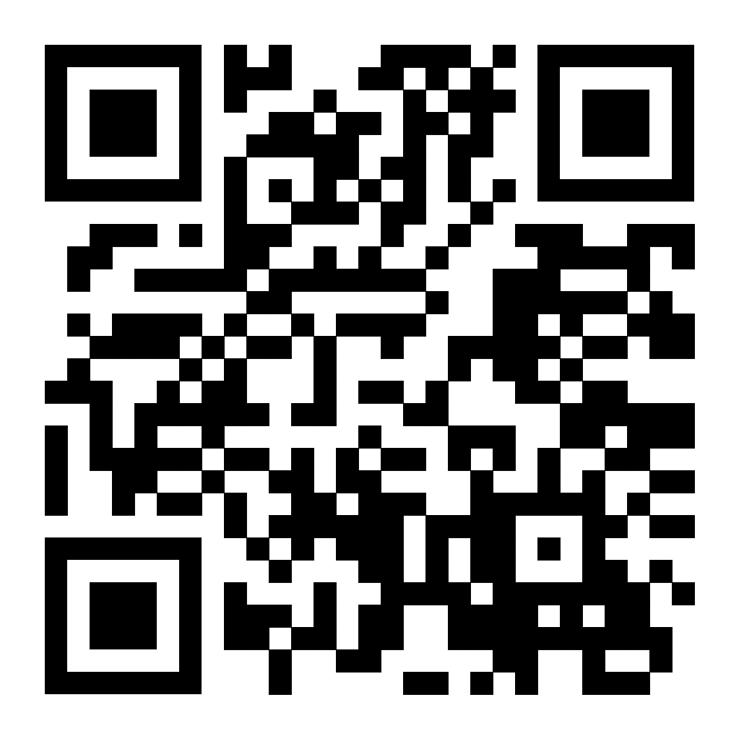
Project Design Models

Slide 8
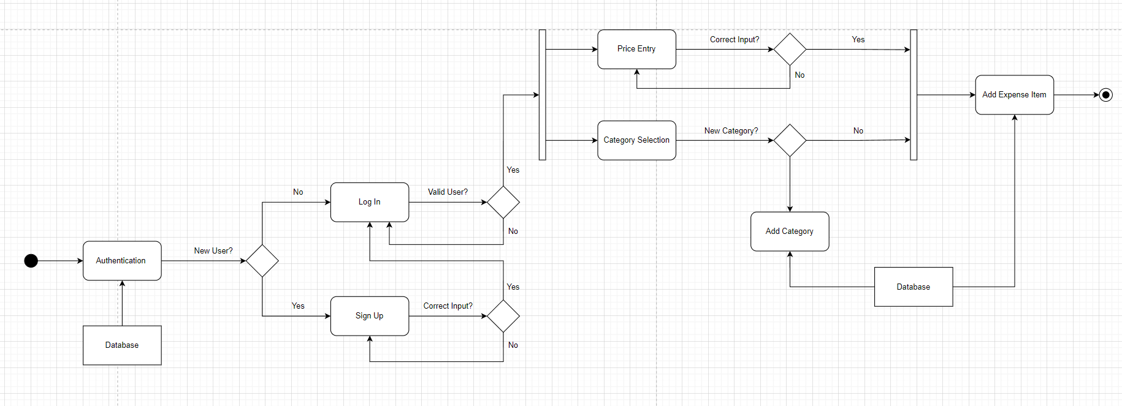
Activity Diagram:

Slide 9
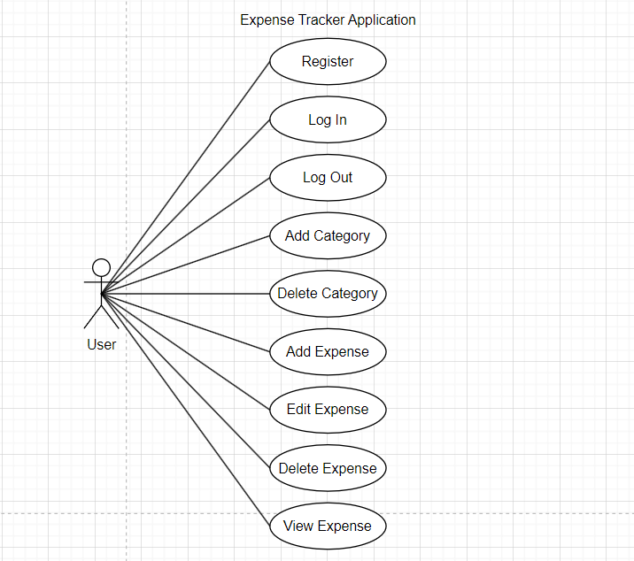
Use Case Diagram:

Slide 10
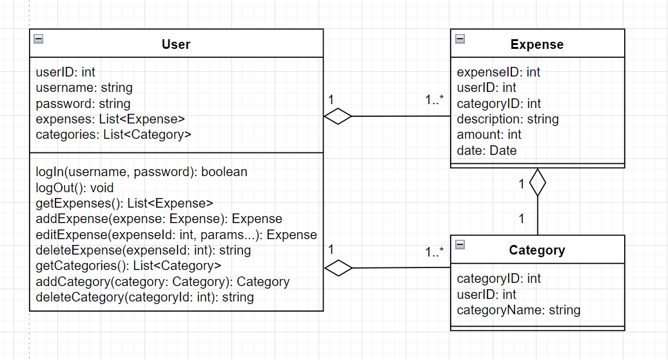
Class diagram:

Slide 11
Database Design

Slide 12
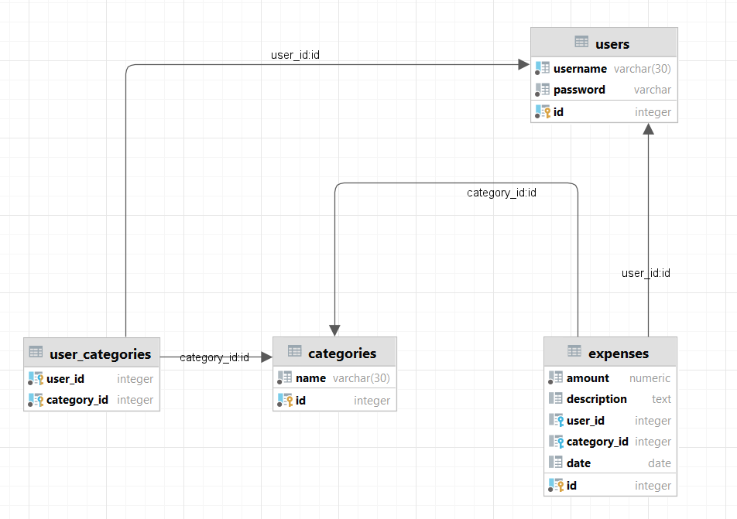
Database Schema:

Slide 13
What is done?

Slide 14

Project Goals:
Create a user-friendly and intuitive GUI for expense entry and management.
Allow users to categorize expenses.
Ensure data privacy and security by implementing authentication.

Slide 15
Project Features:
User Registration and Login
Expense Categories and Listing
Reports (pie charts)
Sorting and Filters
Data Export
Security and Privacy

Slide 16
Python libraries used in this project
Psycopg2: connecting and making queries to database
Bcrypt: security purposes
Pandas: managing dataframes
PySide6: for UI

Slide 17
Tools used in this project
Diagrams: diagrams.net (draw.io)
IDE: Visual Studio Code (by Microsoft)
Database: DataGrip (by JetBrains)

Slide 18
Demonstration

